Slide 1

Fault Tolerant Architecture
Building resilient and reliable software systems is paramount in today's demanding landscape. This presentation will delve into the principles of fault tolerance, explore common patterns, and showcase how to implement these techniques.
Ahmad M. Satria A.

Slide 2
Understanding Fault Tolerance: Why it Matters
Resilience
Availability
Fault tolerance ensures that your system remains operational even when components fail or experience unexpected issues.
By preventing cascading failures, fault tolerance helps maintain continuous service availability for your users.

Slide 3
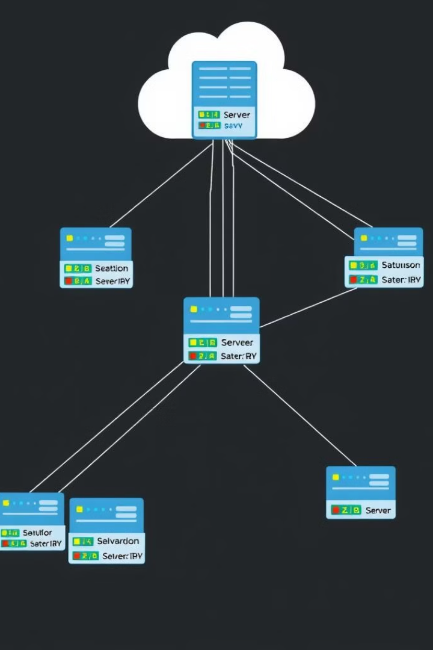
Core Principles: Redundancy, Isolation, and Monitoring
Redundancy replicates components, ensuring backups in case of failure.
Isolation prevents failures in one component from affecting others.
Monitoring tracks system health and alerts developers to potential issues.

Slide 4

Common Fault Tolerance Patterns: An Overview
1
Retry
Automatically reattempt failed operations, allowing for transient network issues or temporary resource unavailability.
2
Timeout
Set time limits for operations to prevent them from blocking indefinitely and causing cascading failures.
3
Circuit Breaker
Prevent cascading failures by isolating failing components, enabling graceful degradation and protecting the overall system.
4
Bulkhead
Isolate components into separate containers, preventing a failure in one from impacting others.

Slide 5
Deep Dive: The Circuit Breaker Pattern
Circuit Breaker pattern is a fault tolerance mechanism used in distributed systems to prevent cascading failures and improve system resilience and availability. It works by temporarily blocking requests to a failing service, allowing it to recover instead of overwhelming it with continuous requests.

Slide 6
Why Use Circuit Breaker?
Prevent system-wide failures from propagating
Reduces latency by avoiding long timeouts
Allows services to recover without overload
Ensures fallback responses for better user experience

Slide 7
When to Use Circuit Breaker?
Calling external APIs or microservices
Handling intermittent failures in services
Preventing system overload
Improving Availability and Resilience
Reducing latency from long timeouts
Avoiding cascading failures

Slide 8
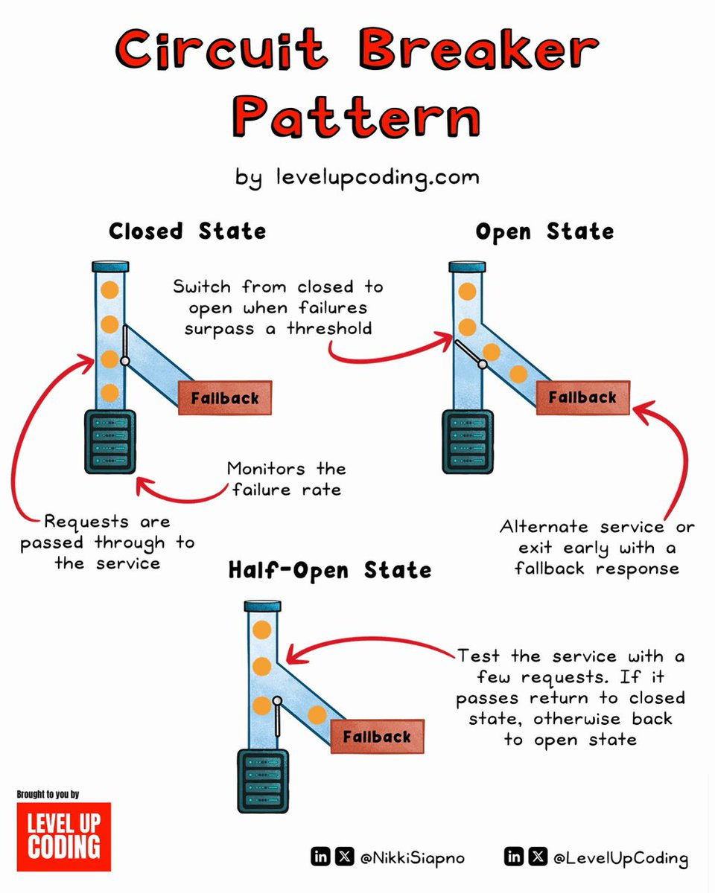
Circuit Breaker States: Open, Closed, Half-Open Explained
1
Closed
The circuit breaker allows requests to pass through to the underlying component.
2
Open
When a certain number of failures occur, the circuit breaker trips, blocking requests and preventing cascading failures.
3
Half-Open
After a timeout, the circuit breaker enters the half-open state, allowing a limited number of requests through to test if the component has recovered.

Slide 9

Implementing Circuit Breaker: Code Example
class CircuitBreaker {
constructor(options: CircuitBreakerOptions) {
// ...
}
async execute(func: () => Promise<any>): Promise<any> {
// ...
}
}
interface CircuitBreakerOptions {
// ...
}

Slide 10



Configuring the Circuit Breaker: Thresholds and Timeouts
Failure Threshold
The number of consecutive failures that trigger the circuit breaker to open.
Timeout Duration
The time interval after which the circuit breaker transitions from open to half-open.
Success Count
The number of successful requests in half-open state required to close the circuit breaker again.

Slide 11
Real-World Examples: Applying Circuit Breaker to Microservices
Microservice A
Microservice A calls Microservice B for data, but Microservice B is experiencing failures.
Circuit Breaker
The circuit breaker for Microservice B is tripped, preventing further requests and allowing Microservice A to gracefully degrade.
Fallback Logic
Microservice A executes fallback logic to handle the failure, providing a degraded experience to the user.

Slide 12
Benefits and Trade-offs of Circuit Breaker
Benefits
Trade-offs
Improved system resilience and availability
Prevention of cascading failures
Graceful degradation and fallback options
Improved performance
Additional complexity to the codebase
Careful configuration required to avoid unwanted trips
Potential for performance overhead if not implemented efficiently
Potential for false positives

Slide 13

Conclusion: Building Resilient Systems with TypeScript
By incorporating fault tolerance patterns like the circuit breaker, your applications can become more robust, ensuring that your systems remain operational and available even when facing unexpected challenges.

